Slide 1
Enhanced stereochemistry
Gerd Blanke
Technical Director of the InChI Trust
Christoph Müller, Djordje Baljozovic, Felix Bänsch, Jan Brammer, Nauman Ullah Khan
InChI discussions
25-June-2026

Slide 2
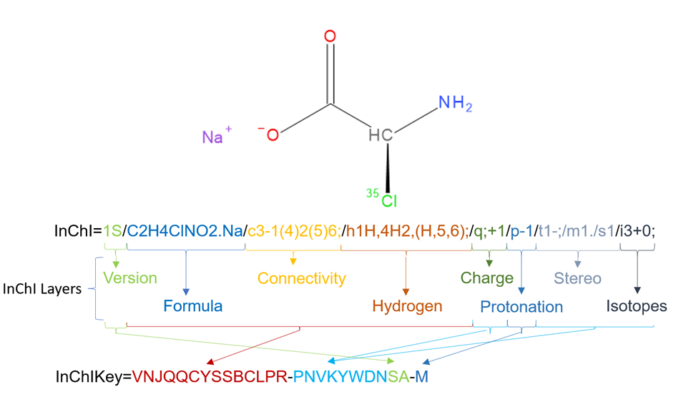
What is InChI?
InChI
Layered ordered molecule collections based on connectivity and ligand counts
Structure-based chemical identifier
Developed by IUPAC and the InChI Trust
Facilitates effective information management across chemistry
InChIKeys
Fixed length InChI hash
Keys note:
Collisions every few billion structures: none in PubChem

Slide 3
What are we working on?
Organic chemistry
  Enhanced stereochemistry (under development)
    Tetrahedral C centers
    E/Z isomers
    Allenes
  (Atropisomers, under development)
Molecular inorganics
  Rebuilt bond handling
    Include coordinative/dative and haptic bonds
  Stereochemistry of molecular inorganics (under development)

Slide 4
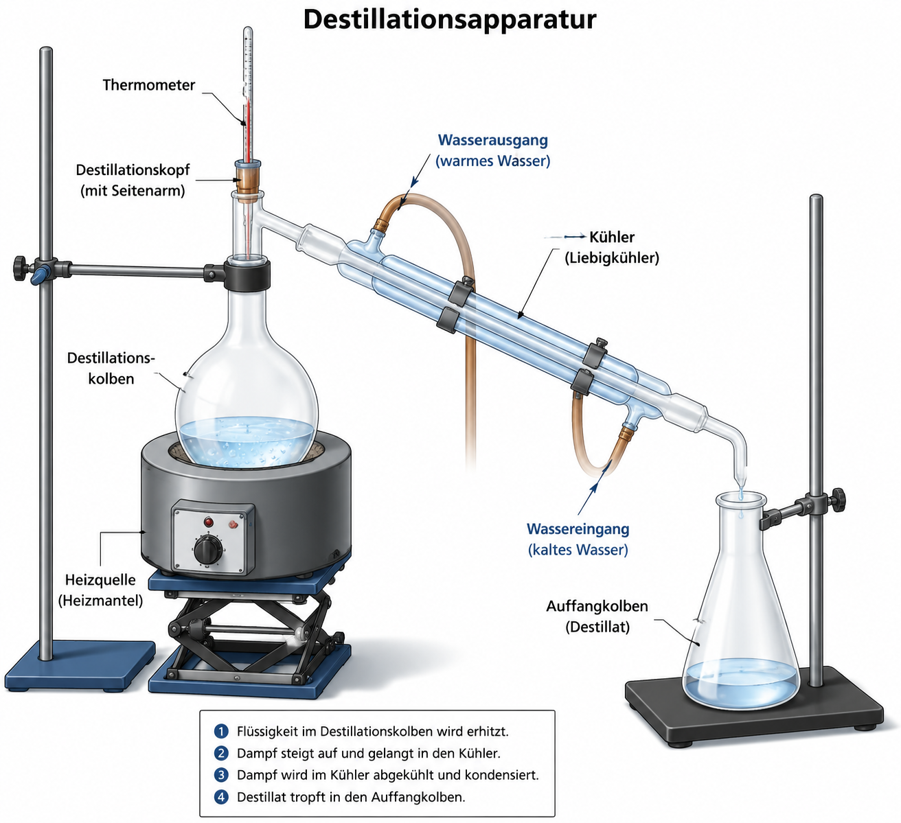
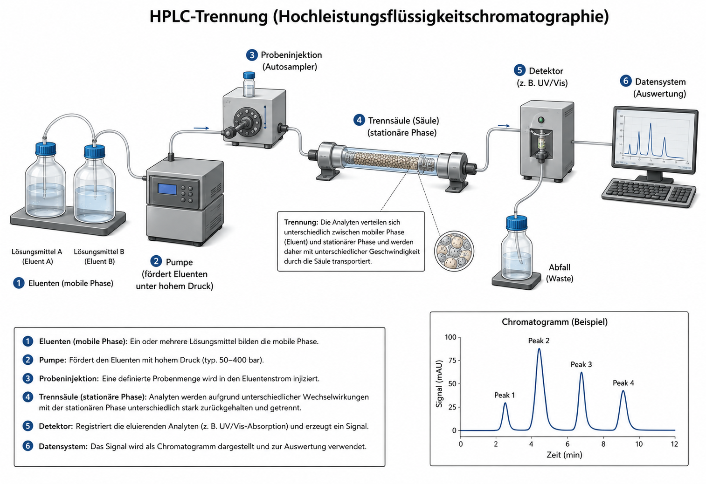
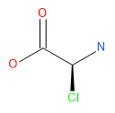
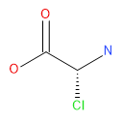
Why do we need enhanced stereochemistry?
Separated but enantiomers not yet determined
Mixture of both enantiomers
Graphics by ChatGPT

Slide 5
Why do we need enhanced stereochemistry?
To speed up research industry started to test substances not only as pure known enantiomers but already as
  Mixtures of enantiomers (enantiomer 1 AND enantiomer 2)
  Pure but (still) unknown enantiomers (enantiomer 1 OR enantiomer 2)
    When analytics have become available and the stereochemistry has become known the structures are corrected by adding the correct stereochemistry and dropping the OR flag.
The cheminformatics tools must be able to recognize the compound being a mixture or pure unknown substance regardless how the stereochemistry has been drawn.

Slide 6
Tetrahedral stereocenters

Slide 7
InChI stereo parameters
Currently available InChI parameters
SAbs (standard InChI),
  Tetrahedral center is absolutely described
SRel
  Tetrahedral center is relatively described
SRac
  Tetrahedral center is racemic (mixture of both enantiomers)
SUCF (Use Chiral Flag)
  With Chiral flag = absolute
  Without Chiral flag = racemic
InChI=1S/C2H4ClNO2/c3-1(4)2(5)6/h1H,4H2,(H,5,6)/t1-/m1/s1 | InChI=1S/C2H4ClNO2/c3-1(4)2(5)6/h1H,4H2,(H,5,6)/t1-/m0/s1
InChI=1/C2H4ClNO2/c3-1(4)2(5)6/h1H,4H2,(H,5,6)/t1-/s2 | InChI=1/C2H4ClNO2/c3-1(4)2(5)6/h1H,4H2,(H,5,6)/t1-/s2
InChI=1/C2H4ClNO2/c3-1(4)2(5)6/h1H,4H2,(H,5,6)/t1-/s3 | InChI=1/C2H4ClNO2/c3-1(4)2(5)6/h1H,4H2,(H,5,6)/t1-/s3
InChI=1/C2H4ClNO2/c3-1(4)2(5)6/h1H,4H2,(H,5,6)/t1-/m1/s1 (with Chiral flag, s3 without flag) | InChI=1/C2H4ClNO2/c3-1(4)2(5)6/h1H,4H2,(H,5,6)/t1-/m0/s1 (with Chiral flag, s3 without flag)

Slide 8
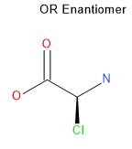
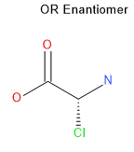
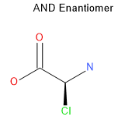
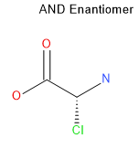
MDL enhanced stereochemistry
 | Drawings |  | Interpretation
Absolutely known enantiomer
Pure but unknown enantiomer
(Racemic) mixture of enantiomers
InChI=1B/C2H4ClNO2/c3-1(4)2(5)6 /h1H,4H2,(H,5,6) /t1-/m1/s1
InChI=1B/C2H4ClNO2/c3-1(4)2(5)6 /h1H,4H2,(H,5,6) /t1-/m0/s1
InChI=1B/C2H4ClNO2/c3-1(4)2(5)6/h1H,4H2,(H,5,6) /t1-/s2
or
InChI=1B/C2H4ClNO2/c3-1(4)2(5)6/h1H,4H2,(H,5,6) /t1-/s3
and

Slide 9
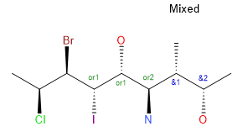
MDL enhanced stereochemistry
1
2
7
10
4
3
5
8
9
6
Current standard InChI
  All centers are seen being abolutely known
  InChI=1S/C10H20BrClINO2/c1-4(6(3)15)9(14)10(16)8(13)7(11)5(2)12/h4-10,15-16H,14H2,1-3H3/t4-,5+,6+,7-,8-,9-,10+/m1/s1
InChI with enhanced stereochemistry
  Centers are represented according to their stereochemistry
    Related centers are grouped, e.g. or1, or2
    Multiple groups are ordered alphanumerically beginning with the lowest number
  InChI=1B/C10H20BrClINO2/c1-4(6(3)15)9(14)10(16)8(13)7(11)5(2)12/h4-10,15-16H,14H2,1-3H3/t4-,5-,6-,7+,8-,9-,10+/m0/s1(5,7)2(8,10)(9)3(4)(6)
Note
  The string part for the extended sterechemistry is an extension to the stereochemistry layer of the current standard InChI

Slide 10
MDL enhanced stereochemistry – Edge cases
If all stereochenters belong to the same representation class (e.g. ABS, OR1, AND1) they represent the same structure drawn as V2 molfile with the related InChI parameters SAbs, SRel, SRac.
  In case the structure consists out of one stereo class (e.g. ABS, OR1, AND1) only, the additional index grouping used for the enhanced stereochemistry is redundant and is not to be used.
  /m0 and /m1 are only used in the context of absolute centers.
    In case that the structure only contains OR# and/or AND# centers /m# is obsolete abd must not be used.

Slide 11
MDL enhanced stereochemistry – Edge cases
 | Drawings |  | Interpretations
Absolutely known enantiomer
Pure but unknown enantiomer
(Racemic) mixture of enantiomers
Enhanced stereo:
InChI=1B/C2H4ClNO2/c3-1(4)2(5)6 /h1H,4H2,(H,5,6) /t1-/m1/s1
Standard / SAbs:
InChI=1S/C2H4ClNO2/c3-1(4)2(5)6 /h1H,4H2,(H,5,6) /t1-/m1/s1
Enhanced stereo:
InChI=1B/C2H4ClNO2/c3-1(4)2(5)6 /h1H,4H2,(H,5,6) /t1-/m0/s1
Standard / SAbs:
InChI=1S/C2H4ClNO2/c3-1(4)2(5)6 /h1H,4H2,(H,5,6)/t1-/m0/s1
Enhanced stereo:
InChI=1B/C2H4ClNO2 /c3-1(4)2(5)6/h1H, 4H2,(H,5,6)/t1-/s2
/SRel:
InChI=1/C2H4ClNO2/c3-1(4)2(5)6/h1H, 4H2,(H,5,6)/t1-/s2
or
Enhanced stereo:
InChI=1B/C2H4ClNO2 /c3-1(4)2(5)6/h1H, 4H2,(H,5,6)/t1-/s3
/SRac:
InChI=1/C2H4ClNO2/c3-1(4)2(5)6/h1H, 4H2,(H,5,6)/t1-/s3
and

Slide 12
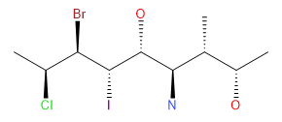

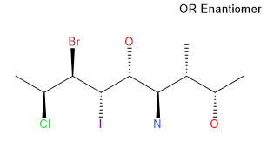
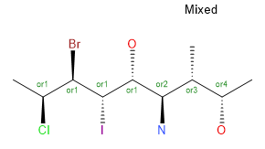
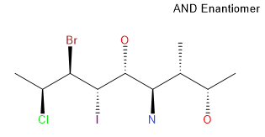
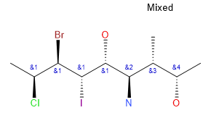
MDL enhanced stereochemistry – Edge cases
1
2
7
10
4
3
5
8
9
6
Drawing | InChI with enhanced stereochemistry
 | InChI=1B/C10H20BrClINO2/c1-4(6(3)15)9(14)10(16)8(13)7(11)5(2)12/h4-10,15-16H,14H2,1-3H3/t4-,5+,6+,7-,8-,9-,10+/m1/s1
 | InChI=1B/C10H20BrClINO2/c1-4(6(3)15)9(14)10(16)8(13)7(11)5(2)12/h4-10,15-16H,14H2,1-3H3/t4-,5-,6-,7+,8-,9-,10+/m0/s1(5,7)2(8,10)(9)3(4)(6)
 | InChI=1B/C10H20BrClINO2/c1-4(6(3)15)9(14)10(16)8(13)7(11)5(2)12/h4-10,15-16H,14H2,1-3H3/t4-,5+,6+,7-,8-,9-,10+/s2
 | InChI=1B/C10H20BrClINO2/c1-4(6(3)15)9(14)10(16)8(13)7(11)5(2)12/h4-10,15-16H,14H2,1-3H3/t4-,5-,6-,7+,8+,9-,10-/s2(4)(5,7, 8,10)(6)(9)
 | InChI=1B/C10H20BrClINO2/c1-4(6(3)15)9(14)10(16)8(13)7(11)5(2)12/h4-10,15-16H,14H2,1-3H3/t4-,5+,6+,7-,8-,9-,10+/s3
 | InChI=1B/C10H20BrClINO2/c1-4(6(3)15)9(14)10(16)8(13)7(11)5(2)12/h4-10,15-16H,14H2,1-3H3/t4-,5-,6-,7+,8+,9-,10-/s3(4)(5,7,8,10)(6)(9)

Slide 13
Enhanced stereochemistry
The concept of the enhanced stereochemistry has been transferred to non-tetrahedral stereocenters:
  Allenes
  Atropisomers
  Double bonds (E/Z)

Slide 14
Allenes

Slide 15


Tetrahedral stereocenters
To let InChI recognize the stereochemistry of allenes each of the and atoms of the allene section have to be marked by a stereobond
  Only the combinations up/up and down/down are handled.
Although allenes are described by stereoaxes, InChI uses the central C atom of the conjugated double bonds to identify the stereochemistry.
  The /t layer is used to keep the stereoinformation analog to the tetrahedral centers
2
InChI=1B/C4H3BrClF/c1-3(6)2-4(5)7/h1H3/t2-/m1/s1
2
InChI=1B/C4H3BrClF/c1-3(6)2-4(5)7/h1H3/t2-/m0/s1
2

Slide 16
InChI stereo parameters
Currently available InChI parameters
SAbs (standard InChI),
  Stereoaxis is absolutely described
SRel
  Stereoaxis is relatively described
SRac
  Stereoaxis is racemic (mixture of both enantiomers)
SUCF (Use Chiral Flag)
  With Chiral flag = absolute (here not valid)
  Without Chiral flag = racemic
InChI=1S/C4H3BrClF/c1-3(6)2-4(5)7/h1H3/t2-/m0/s1 | InChI=1S/C4H3BrClF/c1-3(6)2-4(5)7/h1H3/t2-/m1/s1
InChI=1/C4H3BrClF/c1-3(6)2-4(5)7/h1H3/t2-/s2 | InChI=1/C4H3BrClF/c1-3(6)2-4(5)7/h1H3/t2-/s2
InChI=1/C4H3BrClF/c1-3(6)2-4(5)7/h1H3/t2-/s3 | InChI=1/C4H3BrClF/c1-3(6)2-4(5)7/h1H3/t2-/s3
InChI=1/C4H3BrClF/c1-3(6)2-4(5)7/h1H3/t2-/s2 (Chiral flag not valid, should be s3 without flag) | InChI=1/C4H3BrClF/c1-3(6)2-4(5)7/h1H3/t2-/s2 (Chiral flag not valid, should be s3 without flag)

Slide 17
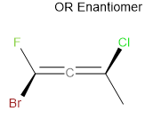
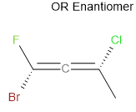
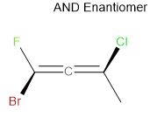
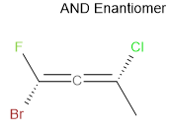
Enhanced stereochemistry - allenes
 | Drawings |  | Interpretation
Absolutely known enantiomer
Pure but unknown enantiomer
(Racemic) mixture of enantiomers
InChI=1S/C4H3BrClF/c1-3(6)2-4(5)7/h1H3/t2-/m1/s1
InChI=1S/C4H3BrClF/c1-3(6)2-4(5)7/h1H3/t2-/m0/s1
InChI=1S/C4H3BrClF/c1-3(6)2-4(5)7/h1H3/t2-/s2
or
InChI=1S/C4H3BrClF/c1-3(6)2-4(5)7/h1H3/t2-/s3
and

Slide 18
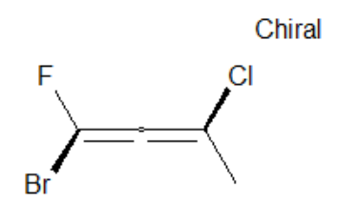
Enhanced stereochemistry – allenes
Pure known configuration
Drawing | V2 molfile | Enh. Stereo: absolute (V3) | Notes
or InChI=1S/C4H3BrClF/c1-3(6)2-4(5)7 /h1H3/t2-/m1/s1 | -ISIS- 07032617432D 7 6 0 0 1 0 0 0 0 0999 V2000 0.0411 -0.2833 0.0000 Br 0 0 0 0 0 0 0 0 0 0 0 0 0.6316 0.7395 0.0000 C 0 0 0 0 0 0 0 0 0 0 0 0 1.8127 0.7395 0.0000 C 0 0 0 0 0 0 0 0 0 0 0 0 2.9938 0.7395 0.0000 C 0 0 0 0 0 0 0 0 0 0 0 0 3.5844 1.7624 0.0000 Cl 0 0 0 0 0 0 0 0 0 0 0 0 3.5844 -0.2833 0.0000 C 0 0 0 0 0 0 0 0 0 0 0 0 0.0411 1.7624 0.0000 F 0 0 0 0 0 0 0 0 0 0 0 0 2 1 1 1 0 0 0 2 3 2 0 0 0 0 3 4 2 0 0 0 0 4 5 1 1 0 0 0 4 6 1 0 0 0 0 2 7 1 0 0 0 0 M END | ACCLDraw07032617502D 0 0 0 0 0 999 V3000 M V30 BEGIN CTAB M V30 COUNTS 7 6 0 0 1 M V30 BEGIN ATOM M V30 1 C 5.7812 -4.0938 0 0 M V30 2 C 4.6005 -4.0938 0 0 M V30 3 C 6.9621 -4.0938 0 0 M V30 4 C 7.5524 -5.1163 0 0 M V30 5 Cl 7.5524 -3.0712 0 0 M V30 6 Br 4.0101 -5.1163 0 0 M V30 7 F 4.0101 -3.0712 0 0 M V30 END ATOM M V30 BEGIN BOND M V30 1 2 2 1 M V30 2 2 1 3 M V30 3 1 3 4 M V30 4 1 3 5 CFG=1 M V30 5 1 2 6 CFG=1 M V30 6 1 2 7 M V30 END BOND M V30 BEGIN COLLECTION M V30 MDLV30/STEABS ATOMS=(1 1) M V30 END COLLECTION M V30 END CTAB M END | Both molfiles represent the same compound. As an identifier, the InChI for both of the structures must be identical. Proposal: in case of “abs axial enhanced stereochemistry” use the standard InChI representation.

Slide 19
Enhanced stereochemistry – allenes
Pure but unknown configuration
Drawing | V3 molfile | Drawing | V3 molfile | Proposal
 | ACCLDraw07032617572D 0 0 0 0 0 999 V3000 M V30 BEGIN CTAB M V30 COUNTS 7 6 0 0 0 M V30 BEGIN ATOM M V30 1 C 8.25 -3.6563 0 0 M V30 2 C 7.0693 -3.6563 0 0 M V30 3 C 9.4307 -3.6563 0 0 M V30 4 C 10.0212 -4.6788 0 0 M V30 5 Cl 10.0212 -2.6337 0 0 M V30 6 Br 6.4788 -4.6788 0 0 M V30 7 F 6.4788 -2.6337 0 0 M V30 END ATOM M V30 BEGIN BOND M V30 1 2 2 1 M V30 2 2 1 3 M V30 3 1 3 4 M V30 4 1 3 5 CFG=3 M V30 5 1 2 6 CFG=3 M V30 6 1 2 7 M V30 END BOND M V30 BEGIN COLLECTION M V30 MDLV30/STEREL1 ATOMS=(1 1) M V30 END COLLECTION M V30 END CTAB M END InChI=1S/C4H3BrClF/c1-3(6)2-4(5)7/h1H3/t2-/s2 |  | ACCLDraw07032617532D 0 0 0 0 0 999 V3000 M V30 BEGIN CTAB M V30 COUNTS 7 6 0 0 0 M V30 BEGIN ATOM M V30 1 C 5.8125 -9.8438 0 0 M V30 2 C 4.6317 -9.8438 0 0 M V30 3 C 6.9933 -9.8438 0 0 M V30 4 C 7.5836 -10.8663 0 0 M V30 5 Cl 7.5836 -8.8212 0 0 M V30 6 Br 4.0414 -10.8663 0 0 M V30 7 F 4.0414 -8.8212 0 0 M V30 END ATOM M V30 BEGIN BOND M V30 1 2 2 1 M V30 2 2 1 3 M V30 3 1 3 4 M V30 4 1 3 5 CFG=1 M V30 5 1 2 6 CFG=1 M V30 6 1 2 7 M V30 END BOND M V30 BEGIN COLLECTION M V30 MDLV30/STEREL1 ATOMS=(1 1) M V30 END COLLECTION M V30 END CTAB M END InChI=1S/C4H3BrClF/c1-3(6)2-4(5)7/h1H3/t2-/s2 | Use «2» analog to the enhanced stereochemistry of (organic) tetrahedral OR# centers. Multiple OR geometries are ordered ascendendly by the atom numbers In case of OR# with #= 1,2,…. set each block of related groups in brackets and add # in front of the first atom group of each block. Separate each block by «,».

Slide 20
Enhanced stereochemistry – allenes
(Racemic) mixture
Drawing | V2 molfile | V3 molfile | Drawing | V2 molfile | V3 molfile | Proposal
Or | ACCLDraw07032618332D 7 6 0 0 0 0 0 0 0 0999 V2000 4.7564 -8.1250 0.0000 C 0 0 0 0 0 0 0 0 0 0 0 0 5.9375 -8.1250 0.0000 C 0 0 0 0 0 0 0 0 0 0 0 0 7.1186 -8.1250 0.0000 C 0 0 0 0 0 0 0 0 0 0 0 0 7.7092 -9.1479 0.0000 C 0 0 0 0 0 0 0 0 0 0 0 0 7.7092 -7.1021 0.0000 Cl 0 0 0 0 0 0 0 0 0 0 0 0 4.1658 -9.1479 0.0000 Br 0 0 0 0 0 0 0 0 0 0 0 0 4.1658 -7.1021 0.0000 F 0 0 0 0 0 0 0 0 0 0 0 0 1 2 2 0 0 0 0 2 3 2 0 0 0 0 3 4 1 0 0 0 0 3 5 1 6 0 0 0 1 6 1 6 0 0 0 1 7 1 0 0 0 0 M END | ACCLDraw07032618352D 0 0 0 0 0 999 V3000 M V30 BEGIN CTAB M V30 COUNTS 7 6 0 0 0 M V30 BEGIN ATOM M V30 1 C 7.6719 -9.875 0 0 M V30 2 C 6.4911 -9.875 0 0 M V30 3 Br 5.9007 -10.8976 0 0 M V30 4 F 5.9007 -8.8524 0 0 M V30 5 C 8.8526 -9.875 0 0 M V30 6 C 9.443 -10.8976 0 0 M V30 7 Cl 9.443 -8.8524 0 0 M V30 END ATOM M V30 BEGIN BOND M V30 1 2 2 1 M V30 2 1 2 3 CFG=3 M V30 3 1 2 4 M V30 4 2 1 5 M V30 5 1 5 6 M V30 6 1 5 7 CFG=3 M V30 END BOND M V30 BEGIN COLLECTION M V30 MDLV30/STERAC1 ATOMS=(1 1) M V30 END COLLECTION M V30 END CTAB M END | Or | ACCLDraw07032618342D 7 6 0 0 0 0 0 0 0 0999 V2000 4.7251 -3.9063 0.0000 C 0 0 0 0 0 0 0 0 0 0 0 0 5.9062 -3.9063 0.0000 C 0 0 0 0 0 0 0 0 0 0 0 0 7.0874 -3.9063 0.0000 C 0 0 0 0 0 0 0 0 0 0 0 0 7.6779 -4.9291 0.0000 C 0 0 0 0 0 0 0 0 0 0 0 0 7.6779 -2.8834 0.0000 Cl 0 0 0 0 0 0 0 0 0 0 0 0 4.1346 -4.9291 0.0000 Br 0 0 0 0 0 0 0 0 0 0 0 0 4.1346 -2.8834 0.0000 F 0 0 0 0 0 0 0 0 0 0 0 0 1 2 2 0 0 0 0 2 3 2 0 0 0 0 3 4 1 0 0 0 0 3 5 1 1 0 0 0 1 6 1 1 0 0 0 1 7 1 0 0 0 0 M END | ACCLDraw07032618352D 0 0 0 0 0 999 V3000 M V30 BEGIN CTAB M V30 COUNTS 7 6 0 0 0 M V30 BEGIN ATOM M V30 1 C 7.3906 -4.625 0 0 M V30 2 C 6.2099 -4.625 0 0 M V30 3 Br 5.6195 -5.6476 0 0 M V30 4 F 5.6195 -3.6024 0 0 M V30 5 C 8.5714 -4.625 0 0 M V30 6 C 9.1618 -5.6476 0 0 M V30 7 Cl 9.1618 -3.6024 0 0 M V30 END ATOM M V30 BEGIN BOND M V30 1 2 2 1 M V30 2 1 2 3 CFG=1 M V30 3 1 2 4 M V30 4 2 1 5 M V30 5 1 5 6 M V30 6 1 5 7 CFG=1 M V30 END BOND M V30 BEGIN COLLECTION M V30 MDLV30/STERAC1 ATOMS=(1 1) M V30 END COLLECTION M V30 END CTAB M END | Use «3» analog to the enhanced stereochemistry of (organic) tetrahedral AND# centers. Multiple AND geometries are ordered ascendendly by the atom numbers In case of AND# with #= 1,2,…. set each block of related groups in brackets and add # in front of the first atom group of each block. Separate each block by «,».
 | InChI=1S/C4H3BrClF/c1-3(6)2-4(5)7/h1H3/t2-/s3 |  |  | InChI=1S/C4H3BrClF/c1-3(6)2-4(5)7/h1H3/t2-/s2

Slide 21
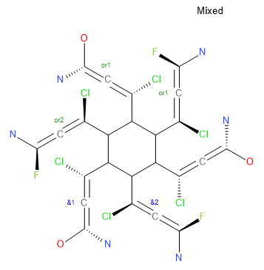
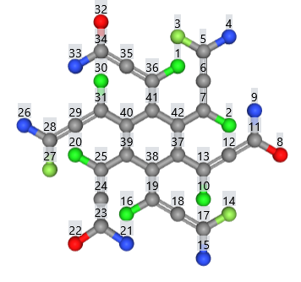
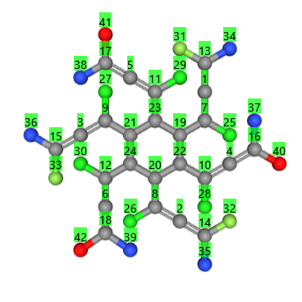
Enhanced stereochemistry – allenes
Drawing | V3 molfile | InChI
 | ACCLDraw06042611322D 0 0 0 0 0 999 V3000 M V30 BEGIN CTAB M V30 COUNTS 42 42 0 0 0 M V30 BEGIN ATOM M V30 1 C 12.1424 -6.8987 0 0 CFG=3 M V30 2 C 13.1653 -6.3081 0 0 CFG=3 M V30 3 C 14.1881 -6.8987 0 0 CFG=3 M V30 4 C 14.1881 -8.0798 0 0 CFG=3 M V30 5 C 13.1653 -8.6703 0 0 CFG=3 M V30 6 C 12.1424 -8.0798 0 0 CFG=3 M V30 7 C 13.1653 -5.1274 0 0 M V30 8 C 14.1878 -4.5371 0 0 M V30 9 C 15.2103 -3.9467 0 0 M V30 10 N 16.2329 -4.5371 0 0 M V30 11 O 15.2103 -2.766 0 0 M V30 12 C 15.2107 -6.3083 0 0 M V30 13 Cl 15.2107 -5.1276 0 0 M V30 14 C 16.2332 -6.8987 0 0 M V30 15 C 17.2557 -7.489 0 0 M V30 16 F 17.2557 -8.6698 0 0 M V30 17 N 18.2782 -6.8987 0 0 M V30 18 C 15.2107 -8.6701 0 0 M V30 19 C 15.2107 -9.8509 0 0 M V30 20 C 15.2107 -10.9265 0 0 M V30 21 O 16.2332 -11.6219 0 0 M V30 22 N 14.1881 -11.6219 0 0 M V30 23 Cl 16.2332 -8.0798 0 0 M V30 24 C 13.1653 -9.8511 0 0 M V30 25 C 12.1428 -10.4414 0 0 M V30 26 C 11.1202 -11.0318 0 0 M V30 27 Cl 14.1878 -10.4414 0 0 M V30 28 N 11.1202 -12.2125 0 0 M V30 29 F 10.0977 -10.4414 0 0 M V30 30 C 11.1199 -8.6701 0 0 M V30 31 C 10.0974 -8.0798 0 0 M V30 32 C 9.0749 -7.4894 0 0 M V30 33 Cl 11.1199 -9.8509 0 0 M V30 34 N 9.0749 -6.3087 0 0 M V30 35 O 8.0523 -8.0798 0 0 M V30 36 C 11.1199 -6.3083 0 0 M V30 37 C 11.1199 -5.1276 0 0 M V30 38 C 11.1199 -3.9469 0 0 M V30 39 N 10.0974 -3.3565 0 0 M V30 40 F 12.1424 -3.3565 0 0 M V30 41 Cl 10.0974 -6.8987 0 0 M V30 42 Cl 12.1428 -4.5371 0 0 M V30 END ATOM M V30 BEGIN BOND | InChI=1S/C24H21Cl6F3N6O3/c25-7(1-13(31)34)19-22(10(28)4-16(37)40)20(8(26)2-14(32)35)24(12(30)6-18(39)42)21(9(27)3-15(33)36)23(19)11(29)5-17(38)41/h19-24,40-42H,34-39H2/t1-,2-,3-,4-,5+,6-,19?,20?,21?,22?,23?,24? /m0/s1(4),2(1,5),(3),3(2)(6) ?: undefined stereochemistry at C ring atoms Abs center: 4- related to /m0 OR cenetres: OR1 (1,5); OR2 (3) AND centers: AND1 (6); AND2 (2)
M V30 1 1 1 2
M V30 2 1 3 2
M V30 3 1 4 3
M V30 4 1 5 4
M V30 5 1 1 6
M V30 6 1 6 5
M V30 7 1 2 7
M V30 8 2 7 8
M V30 9 2 8 9
M V30 10 1 9 10 CFG=1
M V30 11 1 9 11
M V30 12 1 3 12
M V30 13 1 12 13 CFG=3
M V30 14 2 12 14
M V30 15 2 14 15
M V30 16 1 15 16 CFG=3
M V30 17 1 15 17
M V30 18 1 4 18
M V30 19 2 18 19
M V30 20 2 19 20
M V30 21 1 20 21
M V30 22 1 20 22 CFG=1
M V30 23 1 18 23 CFG=1
M V30 24 1 5 24
M V30 25 2 24 25
M V30 26 2 25 26
M V30 27 1 24 27 CFG=3
M V30 28 1 26 28
M V30 29 1 26 29 CFG=3
M V30 30 1 6 30
M V30 31 2 30 31
M V30 32 2 31 32
M V30 33 1 30 33 CFG=1
M V30 34 1 32 34 CFG=1
M V30 35 1 32 35
M V30 36 1 1 36
M V30 37 2 36 37
M V30 38 2 37 38
M V30 39 1 38 39
M V30 40 1 38 40 CFG=3
M V30 41 1 36 41 CFG=3
M V30 42 1 7 42 CFG=1
M V30 END BOND
M V30 BEGIN COLLECTION
M V30 MDLV30/STEABS ATOMS=(2 18 31)
M V30 MDLV30/STEREL1 ATOMS=(2 37 8)
M V30 MDLV30/STEREL2 ATOMS=(1 14)
M V30 MDLV30/STERAC1 ATOMS=(1 19)
M V30 MDLV30/STERAC2 ATOMS=(1 25)
M V30 END COLLECTION
M V30 END CTAB
M END

Slide 22
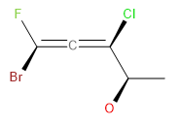
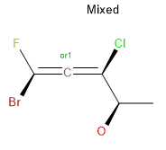
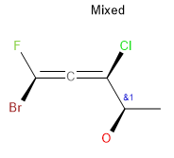
Enhanced stereochemistry – allenes
Combined allene with tetrahedral center, follow the tetrahedral center notation (Examples)
Drawing/InChI | V3 Molfile | Drawing/InChI | V3 Molfile | Drawing/InChI | V3 Molfile
InChI=1S/C5H5BrClFO/c1-3(9)4(7) 2-5(6)8/h3,9H, 1H3/t2-,3-/m1/s1 | ACCLDraw07032619162D 0 0 0 0 0 999 V3000 M V30 BEGIN CTAB M V30 COUNTS 9 8 0 0 1 M V30 BEGIN ATOM M V30 1 C 5.5095 -16.0029 0 0 M V30 2 C 4.3288 -16.0029 0 0 M V30 3 Br 3.7385 -17.0254 0 0 M V30 4 F 3.7385 -14.9803 0 0 M V30 5 C 6.6904 -16.0029 0 0 M V30 6 C 7.2807 -17.0254 0 0 CFG=1 M V30 7 C 8.4614 -17.0254 0 0 M V30 8 O 6.6903 -18.048 0 0 M V30 9 Cl 7.2807 -14.9803 0 0 M V30 END ATOM M V30 BEGIN BOND M V30 1 2 2 1 M V30 2 1 2 3 CFG=1 M V30 3 1 2 4 M V30 4 2 1 5 M V30 5 1 5 6 M V30 6 1 6 7 M V30 7 1 6 8 CFG=1 M V30 8 1 5 9 CFG=1 M V30 END BOND M V30 BEGIN COLLECTION M V30 MDLV30/STEABS ATOMS=(2 1 6) M V30 END COLLECTION M V30 END CTAB M END | InChI=1S/C5H5BrClFO/c1-3(9)4(7) 2-5(6)8/h3,9H, 1H3/t2-,3- /m1/s1(3)2(2) | ACCLDraw07032619222D 0 0 0 0 0 999 V3000 M V30 BEGIN CTAB M V30 COUNTS 9 8 0 0 0 M V30 BEGIN ATOM M V30 1 C 6.2812 -4.7188 0 0 M V30 2 C 5.1005 -4.7188 0 0 M V30 3 Br 4.5101 -5.7413 0 0 M V30 4 F 4.5101 -3.6962 0 0 M V30 5 C 7.4621 -4.7188 0 0 M V30 6 C 8.0524 -5.7413 0 0 CFG=1 M V30 7 Cl 8.0524 -3.6962 0 0 M V30 8 C 9.2331 -5.7413 0 0 M V30 9 O 7.462 -6.7638 0 0 M V30 END ATOM M V30 BEGIN BOND M V30 1 2 2 1 M V30 2 1 2 3 CFG=1 M V30 3 1 2 4 M V30 4 2 1 5 M V30 5 1 5 6 M V30 6 1 5 7 CFG=1 M V30 7 1 6 8 M V30 8 1 6 9 CFG=1 M V30 END BOND M V30 BEGIN COLLECTION M V30 MDLV30/STEABS ATOMS=(1 6) M V30 MDLV30/STEREL1 ATOMS=(1 1) M V30 END COLLECTION M V30 END CTAB M END | InChI=1S/C5H5BrClFO/c1-3(9)4(7) 2-5(6)8/h3,9H, 1H3/t2-,3-/m1/s1(2)3(3) | ACCLDraw07032619232D 0 0 0 0 0 999 V3000 M V30 BEGIN CTAB M V30 COUNTS 9 8 0 0 0 M V30 BEGIN ATOM M V30 1 C 5.7908 -11.0029 0 0 M V30 2 C 4.61 -11.0029 0 0 M V30 3 Br 4.0197 -12.0254 0 0 M V30 4 F 4.0197 -9.9803 0 0 M V30 5 C 6.9716 -11.0029 0 0 M V30 6 C 7.562 -12.0254 0 0 CFG=1 M V30 7 C 8.7427 -12.0254 0 0 M V30 8 O 6.9716 -13.048 0 0 M V30 9 Cl 7.562 -9.9803 0 0 M V30 END ATOM M V30 BEGIN BOND M V30 1 2 2 1 M V30 2 1 2 3 CFG=1 M V30 3 1 2 4 M V30 4 2 1 5 M V30 5 1 5 6 M V30 6 1 6 7 M V30 7 1 6 8 CFG=1 M V30 8 1 5 9 CFG=1 M V30 END BOND M V30 BEGIN COLLECTION M V30 MDLV30/STEABS ATOMS=(1 1) M V30 MDLV30/STERAC1 ATOMS=(1 6) M V30 END COLLECTION M V30 END CTAB M END
2
3
2
2
3
3

Slide 23
E/Z configurations

Slide 24



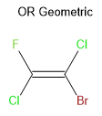

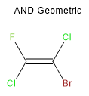
Enhanced stereochemistry – double bonds
Drawing | Meaning | Note
 | Z configuration, defined by the coordinates of the ligand atoms
 | E/Z unknown configuration | Double either bonds are used by Biovia, single either bonds are proposed by IUPAC and implemented by Chemaxon
 |  | Pure but unknown configuration
 |  | (Racemic) mixture of both of the configurations
or
and

Slide 25
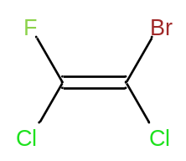
Enhanced stereochemistry – double bonds
Pure known configuration
Drawing | V2, recognition based on the coordinates of the ligand atoms | Enh. Stereo: absolute (V3) | Notes
InChI=1B/C2BrCl2F/c3-1(4)2(5)6/b2-1+ | ACCLDraw05282600312D 6 5 0 0 0 0 0 0 0 0999 V2000 22.4441 -6.6788 0.0000 Cl 0 0 0 0 0 0 0 0 0 0 0 0 23.0344 -5.6563 0.0000 C 0 0 0 0 0 0 0 0 0 0 0 0 22.4439 -4.6334 0.0000 F 0 0 0 0 0 0 0 0 0 0 0 0 24.2155 -5.6563 0.0000 C 0 0 0 0 0 0 0 0 0 0 0 0 24.8061 -4.6335 0.0000 Br 0 0 0 0 0 0 0 0 0 0 0 0 24.8061 -6.6792 0.0000 Cl 0 0 0 0 0 0 0 0 0 0 0 0 1 2 1 0 0 0 0 2 3 1 0 0 0 0 2 4 2 0 0 0 0 4 5 1 0 0 0 0 4 6 1 0 0 0 0 M END | ACCLDraw05282600322D 0 0 0 0 0 999 V3000 M V30 BEGIN CTAB M V30 COUNTS 6 5 0 0 1 M V30 BEGIN ATOM M V30 1 Cl 2.7594 -3.9464 0 0 M V30 2 C 3.35 -2.9236 0 0 M V30 3 F 2.7592 -1.9004 0 0 M V30 4 C 4.5314 -2.9236 0 0 M V30 5 Cl 5.1222 -1.9004 0 0 M V30 6 Br 5.1222 -3.9467 0 0 M V30 END ATOM M V30 BEGIN BOND M V30 1 1 1 2 M V30 2 1 2 3 M V30 3 2 2 4 M V30 4 1 4 5 M V30 5 1 4 6 M V30 END BOND M V30 BEGIN COLLECTION M V30 MDLV30/STEBABS BONDS=(1 3) M V30 END COLLECTION M V30 END CTAB M END | Both molfiles represent the same compound. As an identifier, the InChI for both of the structures must be identical. Proposal: in case of “abs geometries” use the standard InChI representation.

Slide 26
Enhanced stereochemistry – double bonds
Unknown configuration
In case of unknown configurations, the /b layer does not exist
Drawing | V2 molfile | Drawing | V2 molfile
 | ACCLDraw05282616242D 6 5 0 0 0 0 0 0 0 0999 V2000 3.8816 -10.8976 0.0000 Cl 0 0 0 0 0 0 0 0 0 0 0 0 4.4719 -9.8750 0.0000 C 0 0 0 0 0 0 0 0 0 0 0 0 3.8814 -8.8521 0.0000 F 0 0 0 0 0 0 0 0 0 0 0 0 5.6530 -9.8750 0.0000 C 0 0 0 0 0 0 0 0 0 0 0 0 6.2436 -8.8522 0.0000 Cl 0 0 0 0 0 0 0 0 0 0 0 0 6.2435 -10.8980 0.0000 Br 0 0 0 0 0 0 0 0 0 0 0 0 1 2 1 0 0 0 0 2 3 1 0 0 0 0 2 4 2 3 0 0 0 4 5 1 0 0 0 0 4 6 1 0 0 0 0 M END InChI=1B/C2BrCl2F/c3-1(4)2(5)6 |  | ACCLDraw05282616322D 6 5 0 0 0 0 0 0 0 0999 V2000 10.1316 -11.0226 0.0000 Cl 0 0 0 0 0 0 0 0 0 0 0 0 10.7219 -10.0000 0.0000 C 0 0 0 0 0 0 0 0 0 0 0 0 10.1314 -8.9771 0.0000 F 0 0 0 0 0 0 0 0 0 0 0 0 11.9030 -10.0000 0.0000 C 0 0 0 0 0 0 0 0 0 0 0 0 12.4936 -8.9772 0.0000 Cl 0 0 0 0 0 0 0 0 0 0 0 0 12.4935 -11.0230 0.0000 Br 0 0 0 0 0 0 0 0 0 0 0 0 1 2 1 0 0 0 0 2 3 1 0 0 0 0 2 4 2 0 0 0 0 4 5 1 4 0 0 0 4 6 1 0 0 0 0 M END InChI=1B/C2BrCl2F/c3-1(4)2(5)6

Slide 27
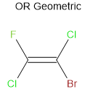
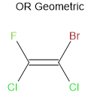
Enhanced stereochemistry – double bonds
Pure but unknown configuration
Drawing | V3 molfile | Drawing | V3 molfile | Proposal
 | ACCLDraw05282616492D 0 0 0 0 0 999 V3000 M V30 BEGIN CTAB M V30 COUNTS 6 5 0 0 0 M V30 BEGIN ATOM M V30 1 Br 9.31 -8.4761 0 0 M V30 2 C 8.7194 -7.4532 0 0 M V30 3 Cl 9.3101 -6.4303 0 0 M V30 4 C 7.5383 -7.4532 0 0 M V30 5 F 6.9478 -6.4302 0 0 M V30 6 Cl 6.948 -8.4757 0 0 M V30 END ATOM M V30 BEGIN BOND M V30 1 1 2 1 M V30 2 1 2 3 M V30 3 2 4 2 M V30 4 1 4 5 M V30 5 1 6 4 M V30 END BOND M V30 BEGIN COLLECTION M V30 MDLV30/STEBREL1 BONDS=(1 3) M V30 END COLLECTION M V30 END CTAB M END InChI=1B/C2BrCl2F/c3-1(4) 2(5)6/b2(2-1-) |  | ACCLDraw05282617022D 0 0 0 0 0 999 V3000 M V30 BEGIN CTAB M V30 COUNTS 6 5 0 0 0 M V30 BEGIN ATOM M V30 1 Cl 7.7123 -9.5855 0 0 M V30 2 C 7.1217 -8.5626 0 0 M V30 3 Br 7.7124 -7.5397 0 0 M V30 4 C 5.9406 -8.5626 0 0 M V30 5 F 5.3501 -7.5396 0 0 M V30 6 Cl 5.3503 -9.5851 0 0 M V30 END ATOM M V30 BEGIN BOND M V30 1 1 2 1 M V30 2 1 2 3 M V30 3 2 4 2 M V30 4 1 4 5 M V30 5 1 6 4 M V30 END BOND M V30 BEGIN COLLECTION M V30 MDLV30/STEBREL1 BONDS=(1 3) M V30 END COLLECTION M V30 END CTAB M END InChI=1B/C2BrCl2F/c3-1(4) 2(5)6/b2(2-1-) | Use «2» for the Rel configuration analog to «s2», alternative: «o» for OR# centers Each bond is represented by their canonicalized atom number pairs starting with the higher number and «-» as orientation for both of the atoms. Proposed format: /b2(2-1-) Multiple OR geometries are ordered ascendendly by the atom number tupples In case of OR# with #= 1,2,…. set each block of related groups in brackets and add # in front of the first atom pair of each block. Separate each block by «,».

Slide 28
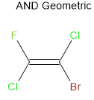
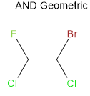
Enhanced stereochemistry – double bonds
(Racemic) mixture
Drawing | V3 molfile | Drawing | V3 molfile | Proposal
 | ACCLDraw05282623592D 0 0 0 0 0 999 V3000 M V30 BEGIN CTAB M V30 COUNTS 6 5 0 0 0 M V30 BEGIN ATOM M V30 1 Br 9.31 -8.4761 0 0 M V30 2 C 8.7194 -7.4532 0 0 M V30 3 Cl 9.3101 -6.4303 0 0 M V30 4 C 7.5383 -7.4532 0 0 M V30 5 F 6.9478 -6.4302 0 0 M V30 6 Cl 6.948 -8.4757 0 0 M V30 END ATOM M V30 BEGIN BOND M V30 1 1 2 1 M V30 2 1 2 3 M V30 3 2 4 2 M V30 4 1 4 5 M V30 5 1 6 4 M V30 END BOND M V30 BEGIN COLLECTION M V30 MDLV30/STEBRAC1 BONDS=(1 3) M V30 END COLLECTION M V30 END CTAB M END InChI=1B/C2BrCl2F/c3-1(4) 2(5)6/b3(2-1-) |  | ACCLDraw05292600022D 0 0 0 0 0 999 V3000 M V30 BEGIN CTAB M V30 COUNTS 6 5 0 0 0 M V30 BEGIN ATOM M V30 1 Cl 9.4936 -13.9917 0 0 M V30 2 C 8.903 -12.9688 0 0 M V30 3 Br 9.4937 -11.9459 0 0 M V30 4 C 7.7219 -12.9688 0 0 M V30 5 F 7.1314 -11.9458 0 0 M V30 6 Cl 7.1316 -13.9913 0 0 M V30 END ATOM M V30 BEGIN BOND M V30 1 1 2 1 M V30 2 1 2 3 M V30 3 2 4 2 M V30 4 1 4 5 M V30 5 1 6 4 M V30 END BOND M V30 BEGIN COLLECTION M V30 MDLV30/STEBRAC1 BONDS=(1 3) M V30 END COLLECTION M V30 END CTAB M END InChI=1B/C2BrCl2F/c3-1(4) 2(5)6/b3(2-1-) | Use «3» for the Rac configuration analog to «s3», alternative: «&» for AND# centers Each bond is represented by their canonicalized atom number pairs starting with the higher number and «-» as orientation for both of the atoms. Proposed format: /b3(2-1-) Multiple AND geometries are ordered ascendendly by the atom number tupples In case of AND# with #= 1,2,…. set each block of related groups in brackets and add # in front of the first atom pair of each block. Separate each block by «,».

Slide 29
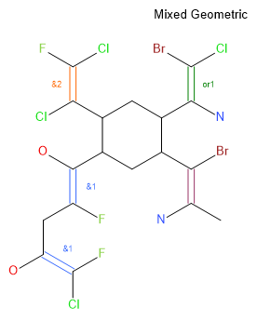
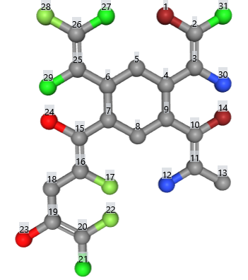
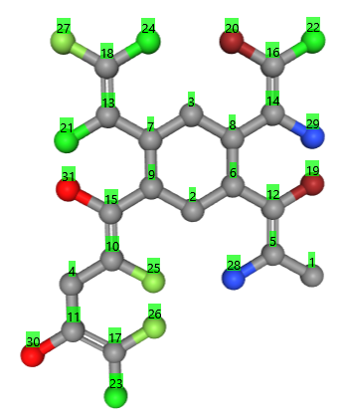
Enhanced stereochemistry – double bonds
Example
Drawing | V3 molfile | InChI
 | ACCLDraw05292600392D 0 0 0 0 0 999 V3000 M V30 BEGIN CTAB M V30 COUNTS 31 31 0 0 0 M V30 BEGIN ATOM M V30 1 Br 9.5751 -2.6288 0 0 M V30 2 C 10.5979 -3.2194 0 0 M V30 3 C 10.5979 -4.4006 0 0 M V30 4 C 9.5751 -4.991 0 0 CFG=3 M V30 5 C 8.5522 -4.4006 0 0 M V30 6 C 7.5293 -4.991 0 0 CFG=3 M V30 7 C 7.5293 -6.1722 0 0 CFG=3 M V30 8 C 8.5522 -6.7628 0 0 M V30 9 C 9.5751 -6.1722 0 0 CFG=3 M V30 10 C 10.5979 -6.7628 0 0 M V30 11 C 10.5979 -7.9439 0 0 M V30 12 N 9.5751 -8.5345 0 0 M V30 13 C 11.6208 -8.5345 0 0 M V30 14 Br 11.6208 -6.1722 0 0 M V30 15 C 6.5065 -6.7628 0 0 M V30 16 C 6.5065 -7.9439 0 0 M V30 17 F 7.5293 -8.5345 0 0 M V30 18 C 5.4835 -8.5345 0 0 M V30 19 C 5.4835 -9.716 0 0 M V30 20 C 6.5067 -10.3067 0 0 M V30 21 Cl 6.5067 -11.4882 0 0 M V30 22 F 7.5299 -9.7159 0 0 M V30 23 O 4.4603 -10.3067 0 0 M V30 24 O 5.4835 -6.1722 0 0 M V30 25 C 6.5065 -4.4006 0 0 M V30 26 C 6.5065 -3.2194 0 0 M V30 27 Cl 7.5293 -2.6288 0 0 M V30 28 F 5.4835 -2.6288 0 0 M V30 29 Cl 5.4835 -4.991 0 0 M V30 30 N 11.6208 -4.991 0 0 M V30 31 Cl 11.6208 -2.6288 0 0 M V30 END ATOM | InChI=1S/C18H19Br2Cl4F3N2O2/c1-5(28)12(19)6-2-9(15(31)10(25)4-11(30)17(23)26)7(13(21)18(24)27) 3-8(6)14(29)16(20)22/h6-9,30-31H,2-4,28-29H2,1H3 /b12-5+,2(16-14-),3(1(15-10-)(17-11-),2(18-13-))
M V30 BEGIN BOND
M V30 1 1 2 1
M V30 2 2 3 2
M V30 3 1 4 3
M V30 4 1 4 5
M V30 5 1 5 6
M V30 6 1 6 7
M V30 7 1 8 7
M V30 8 1 9 4
M V30 9 1 8 9
M V30 10 1 9 10
M V30 11 2 10 11
M V30 12 1 11 12
M V30 13 1 11 13
M V30 14 1 10 14
M V30 15 1 15 7
M V30 16 2 16 15
M V30 17 1 16 17
M V30 18 1 16 18
M V30 19 1 19 18
M V30 20 2 20 19
M V30 21 1 21 20
M V30 22 1 20 22
M V30 23 1 19 23
M V30 24 1 15 24
M V30 25 1 25 6
M V30 26 2 26 25
M V30 27 1 27 26
M V30 28 1 26 28
M V30 29 1 25 29
M V30 30 1 3 30
M V30 31 1 2 31
M V30 END BOND
M V30 BEGIN COLLECTION
M V30 MDLV30/STEBREL1 BONDS=(1 2)
M V30 MDLV30/STEBRAC1 BONDS=(2 16 20)
M V30 MDLV30/STEBRAC2 BONDS=(1 26)
M V30 END COLLECTION
M V30 END CTAB
M END
Molfile index
InChI index

Slide 30
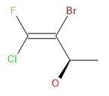
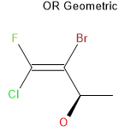
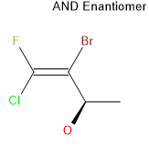
Enhanced stereochemistry – double bonds and tetrahedral centers
Tetrahedral centers / allenes and double bonds must be handled separately (Examples)
V2 Molfile | V3 Molfile | Drawing/InChI | V3 Molfile | Drawing/InChI | V3 Molfile
ACCLDraw07032619442D 8 7 0 0 1 0 0 0 0 0999 V2000 3.5407 -4.4464 0.0000 Cl 0 0 0 0 0 0 0 0 0 0 0 0 4.1312 -3.4236 0.0000 C 0 0 0 0 0 0 0 0 0 0 0 0 3.5405 -2.4004 0.0000 F 0 0 0 0 0 0 0 0 0 0 0 0 5.3127 -3.4236 0.0000 C 0 0 0 0 0 0 0 0 0 0 0 0 5.9034 -2.4004 0.0000 Br 0 0 0 0 0 0 0 0 0 0 0 0 5.9034 -4.4467 0.0000 C 0 0 1 0 0 0 0 0 0 0 0 0 7.0849 -4.4467 0.0000 C 0 0 0 0 0 0 0 0 0 0 0 0 5.3127 -5.4699 0.0000 O 0 0 0 0 0 0 0 0 0 0 0 0 1 2 1 0 0 0 0 2 3 1 0 0 0 0 2 4 2 0 0 0 0 4 5 1 0 0 0 0 4 6 1 0 0 0 0 6 7 1 0 0 0 0 6 8 1 1 0 0 0 M END | ACCLDraw07032619482D 0 0 0 0 0 999 V3000 M V30 BEGIN CTAB M V30 COUNTS 8 7 0 0 1 M V30 BEGIN ATOM M V30 1 Cl 3.5407 -4.4464 0 0 M V30 2 C 4.1312 -3.4236 0 0 M V30 3 F 3.5405 -2.4004 0 0 M V30 4 C 5.3127 -3.4236 0 0 M V30 5 Br 5.9034 -2.4004 0 0 M V30 6 C 5.9034 -4.4467 0 0 CFG=1 M V30 7 C 7.0849 -4.4467 0 0 M V30 8 O 5.3127 -5.4699 0 0 M V30 END ATOM M V30 BEGIN BOND M V30 1 1 1 2 M V30 2 1 2 3 M V30 3 2 2 4 M V30 4 1 4 5 M V30 5 1 4 6 M V30 6 1 6 7 M V30 7 1 6 8 CFG=1 M V30 END BOND M V30 BEGIN COLLECTION M V30 MDLV30/STEABS ATOMS=(1 6) M V30 END COLLECTION M V30 END CTAB M END |  | ACCLDraw07032619572D 0 0 0 0 0 999 V3000 M V30 BEGIN CTAB M V30 COUNTS 8 7 0 0 1 M V30 BEGIN ATOM M V30 1 Br 13.8377 -3.2894 0 0 M V30 2 C 13.2469 -4.3126 0 0 M V30 3 C 13.8377 -5.3357 0 0 CFG=1 M V30 4 C 12.0655 -4.3126 0 0 M V30 5 Cl 11.4749 -5.3354 0 0 M V30 6 F 11.4748 -3.2894 0 0 M V30 7 C 15.0191 -5.3357 0 0 M V30 8 O 13.2469 -6.3589 0 0 M V30 END ATOM M V30 BEGIN BOND M V30 1 1 2 1 M V30 2 1 2 3 M V30 3 2 4 2 M V30 4 1 5 4 M V30 5 1 4 6 M V30 6 1 3 7 M V30 7 1 3 8 CFG=1 M V30 END BOND M V30 BEGIN COLLECTION M V30 MDLV30/STEABS ATOMS=(1 3) M V30 MDLV30/STEBREL2 BONDS=(1 3) M V30 END COLLECTION M V30 END CTAB M END |  | ACCLDraw07032620002D 0 0 0 0 0 999 V3000 M V30 BEGIN CTAB M V30 COUNTS 8 7 0 0 1 M V30 BEGIN ATOM M V30 1 Br 15.0564 -10.8206 0 0 M V30 2 C 14.4657 -11.8438 0 0 M V30 3 C 15.0564 -12.867 0 0 CFG=2 M V30 4 C 13.2842 -11.8438 0 0 M V30 5 Cl 12.6937 -12.8667 0 0 M V30 6 F 12.6935 -10.8206 0 0 M V30 7 O 14.4657 -13.8901 0 0 M V30 8 C 16.2379 -12.867 0 0 M V30 END ATOM M V30 BEGIN BOND M V30 1 1 2 1 M V30 2 1 2 3 M V30 3 2 4 2 M V30 4 1 5 4 M V30 5 1 4 6 M V30 6 1 3 7 CFG=1 M V30 7 1 3 8 M V30 END BOND M V30 BEGIN COLLECTION M V30 MDLV30/STERAC1 ATOMS=(1 3) M V30 MDLV30/STEBABS BONDS=(1 3) M V30 END COLLECTION M V30 END CTAB M END
InChI=1S/C4H5BrClFO/c1-2(8)3(5)4(6) 7/h2,8H,1H3/b4-3-/t2-/m1/s1 |  | InChI=1S/C4H5BrClFO/c1-2(8)3(5)4(6) 7/h2,8H,1H3/b2(4-3-)/t2-/m1/s1 |  | InChI=1S/C4H5BrClFO/c1-2(8)3(5)4(6) 7/h2,8H,1H3/b4-3-/t2-/s3

Slide 31
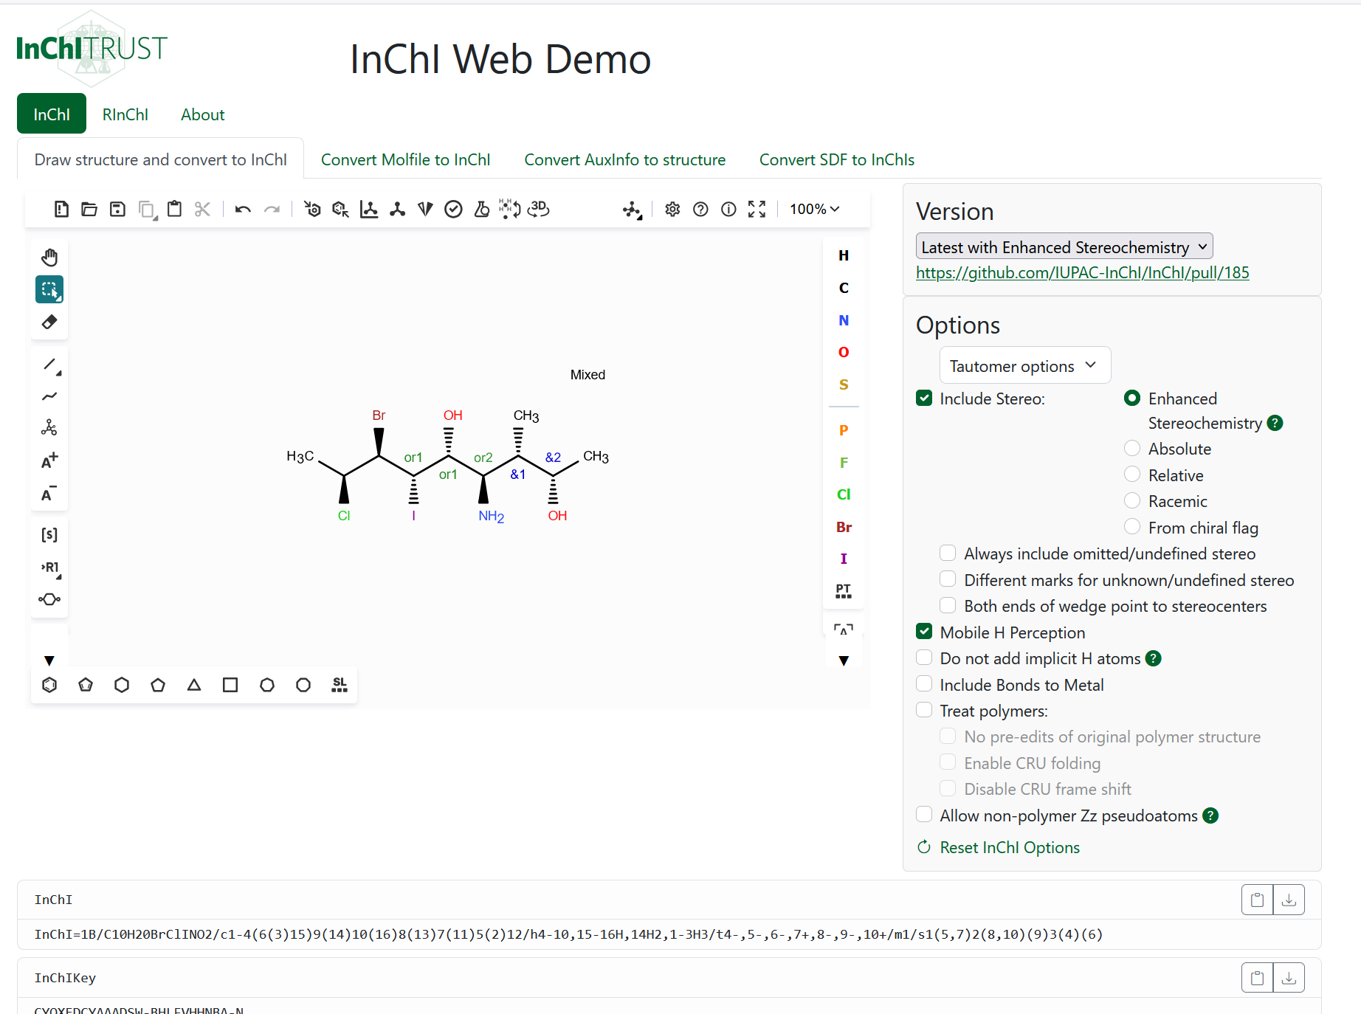

Web-Demo
https://iupac-inchi.github.io/InChI-Web-Demo/

Slide 32
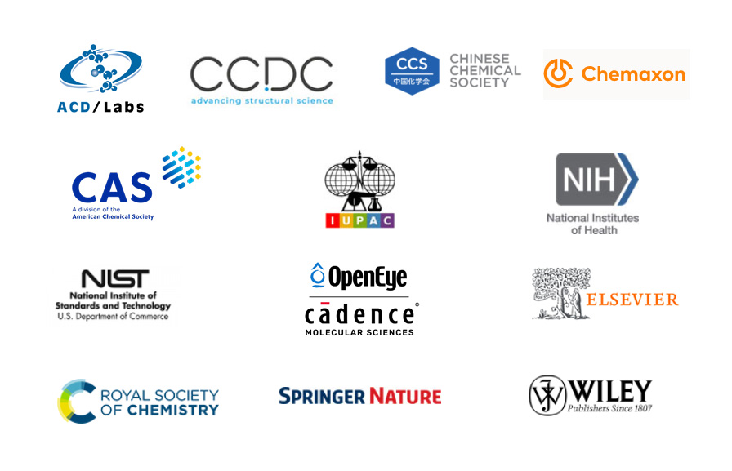


Funding and Support
InChI Trust members 2026
Development partners & financial support
Technical Partners

Slide 33
Thank you

Slide 34
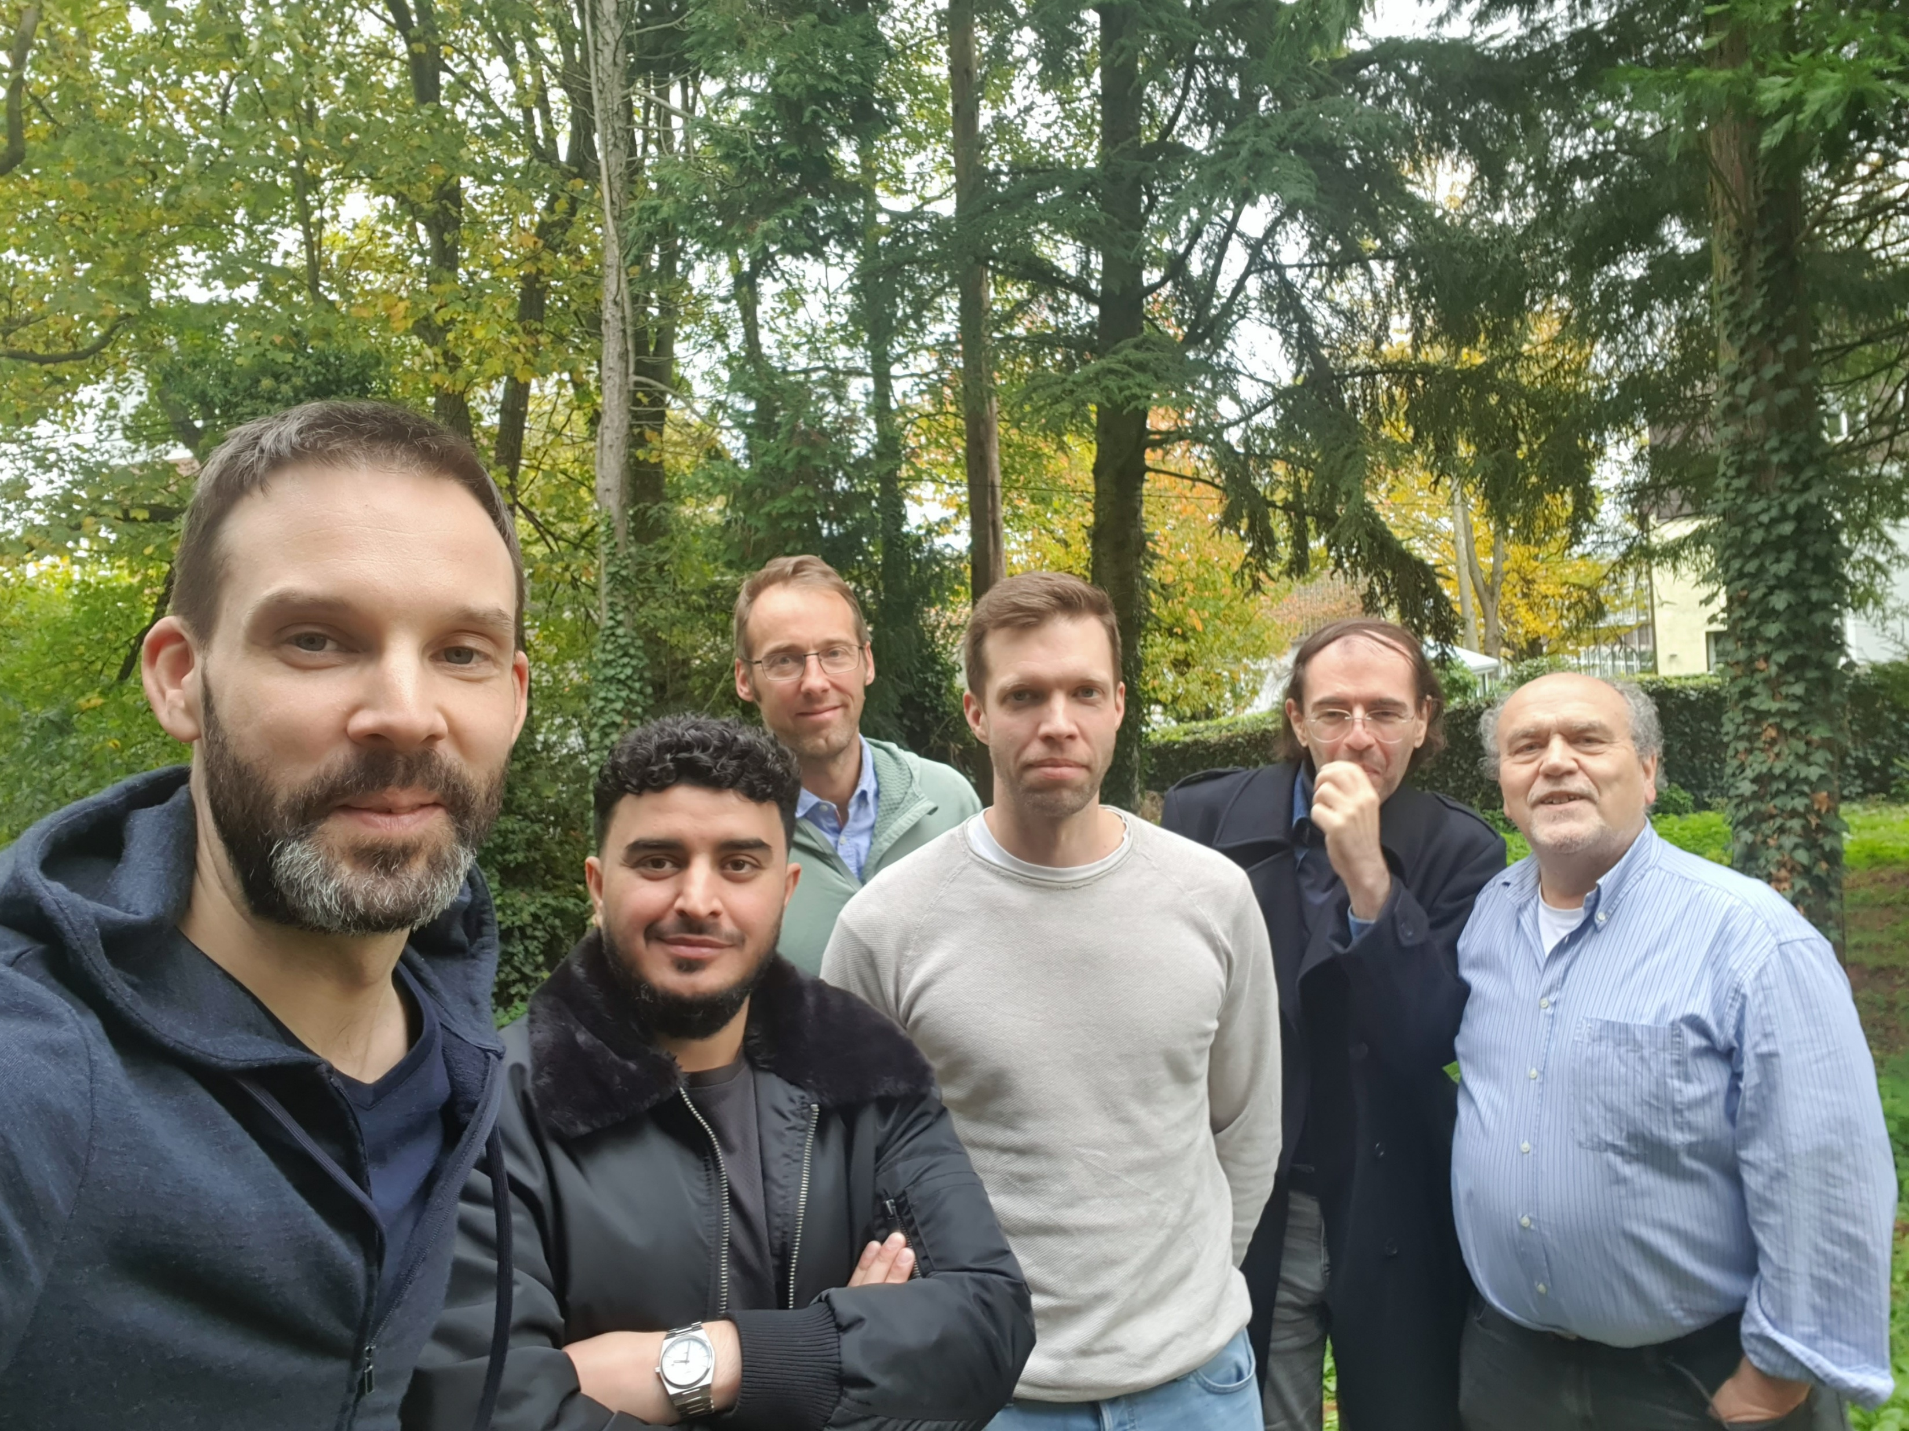
Your InChI development team

